Slide 1
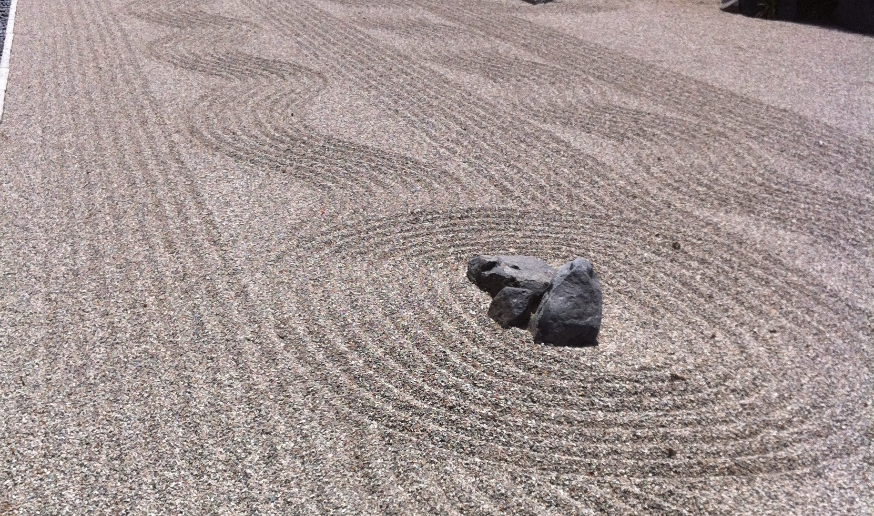
The Zen of KPIs
Bringing Focus to
Your Organization
Steve Mulder
Badh13, Flickr
Notes:
https://www.flickr.com/photos/89379582@N05/15998999276

Slide 2
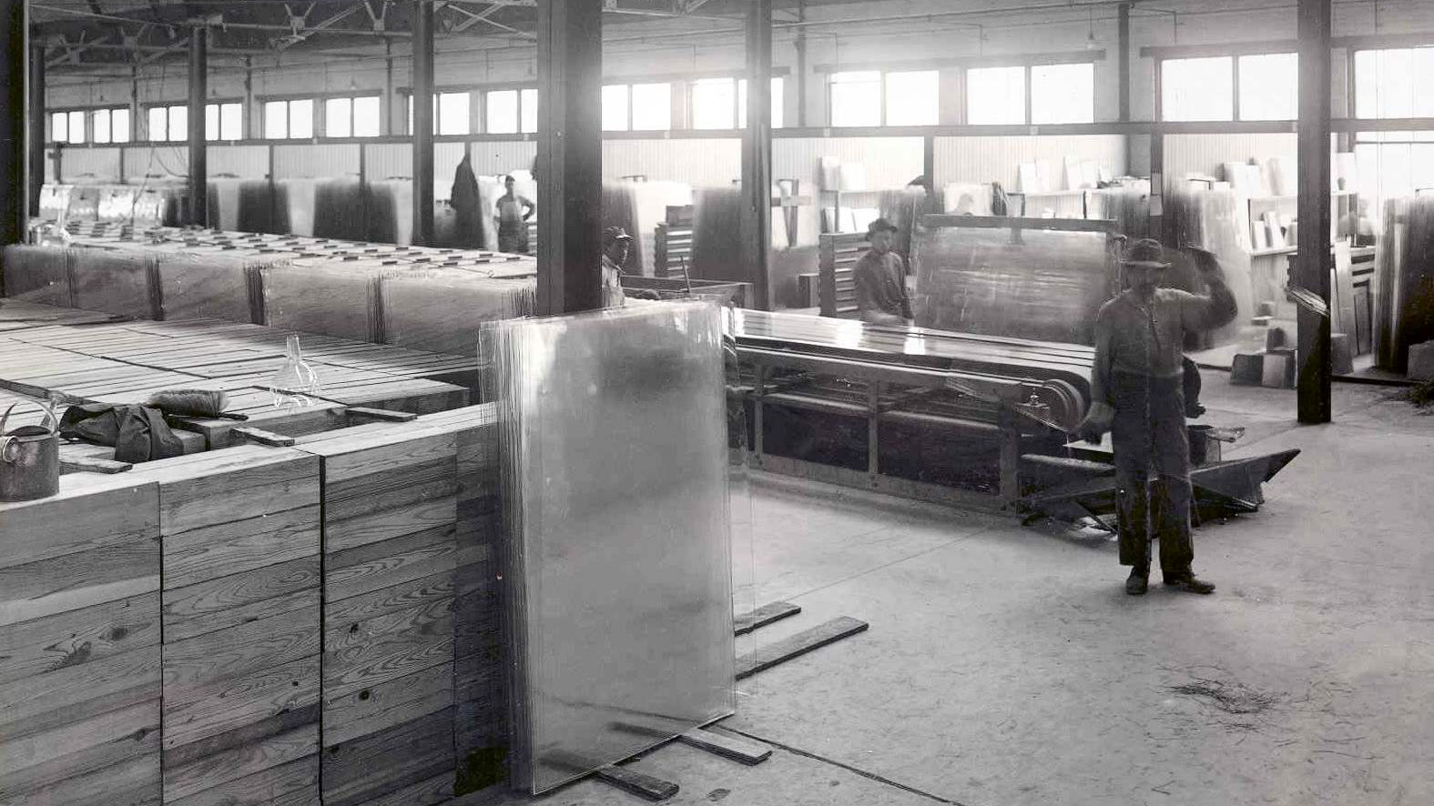
Notes:
In the former Soviet Union, managers of glass plants were at one time rewarded according to the tons of sheet glass produced. Not surprisingly, most plants produced sheet glass so thick that it was nearly opaque. The rules were changed so that they were instead rewarded according to the square meters of glass produced. Under the new rules, firms produced glass so thin that it was easily broken.
http://compliance.saiglobal.com/community/know/blogs/item/4392-unintended-consequences-and-perverse-incentives

Slide 3
Having a goal isn’t enough
You also need the right metrics for that goal
So you can tell which activities make a difference
Notes:
Metric brings goal to life, makes it real
To ensure everyone is moving in the same direction for that goal
So you know if you’re making progress on the goal

Slide 4
Key Performance Indicators
The few metrics that matter most —
key indicators of performance against your goals

Slide 5
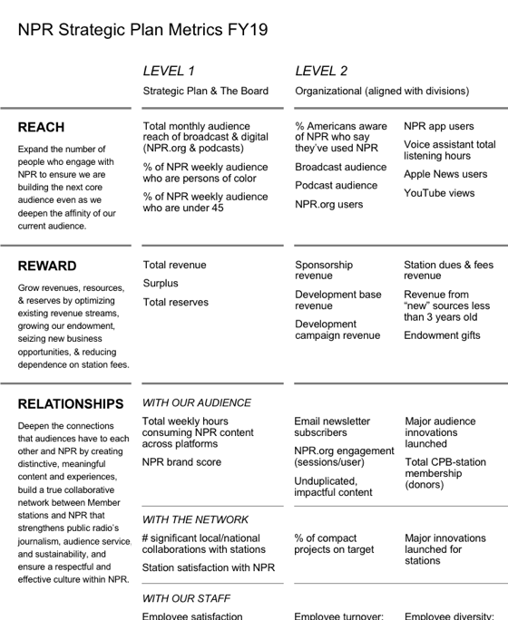
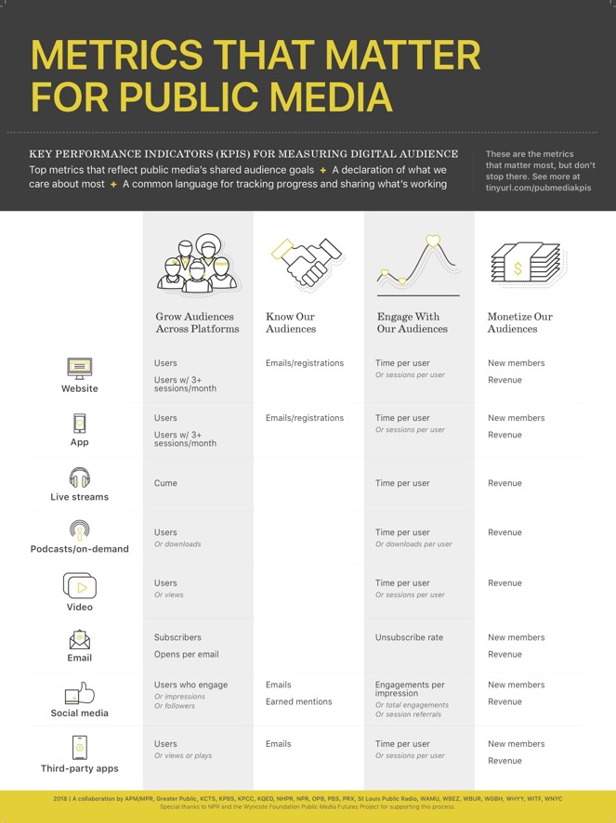
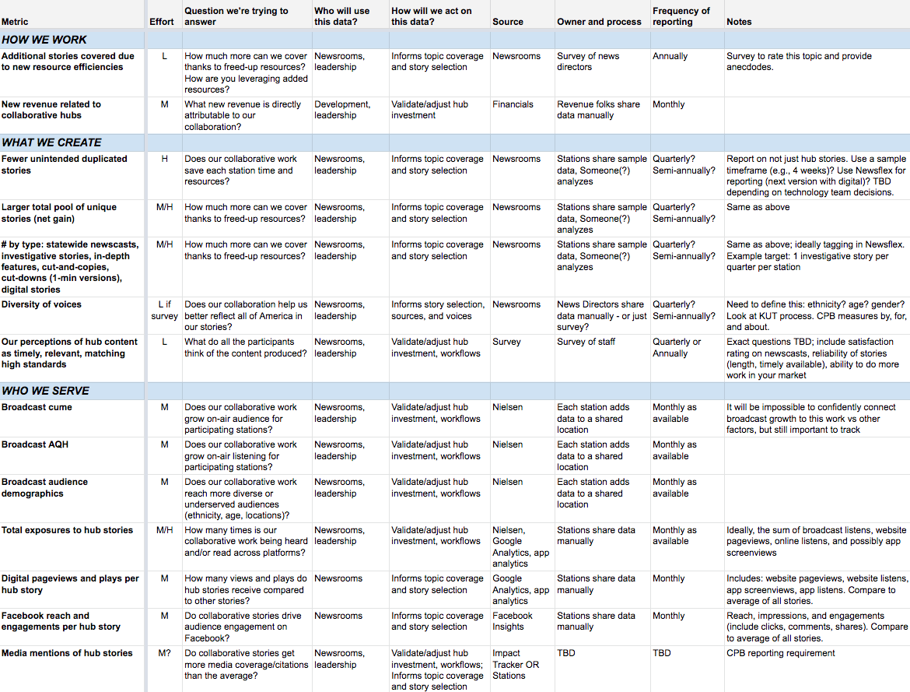
NPR’s KPIs
Public Media Digital Audience KPIs
Texas Journalism Hub
Notes:
Lessons learned:
What makes for a good KPI
How to create them
How to use them

Slide 6
NPR example
Goal
Expand the number of people who engage with NPR to ensure we are building the next core audience even as we deepen the affinity of our current audience.
Example KPI
% of NPR weekly audience who are under 45
Example Target
48% for FY19
Notes:
Tip: document methodology and workflow. We’ll come back to that later.

Slide 7
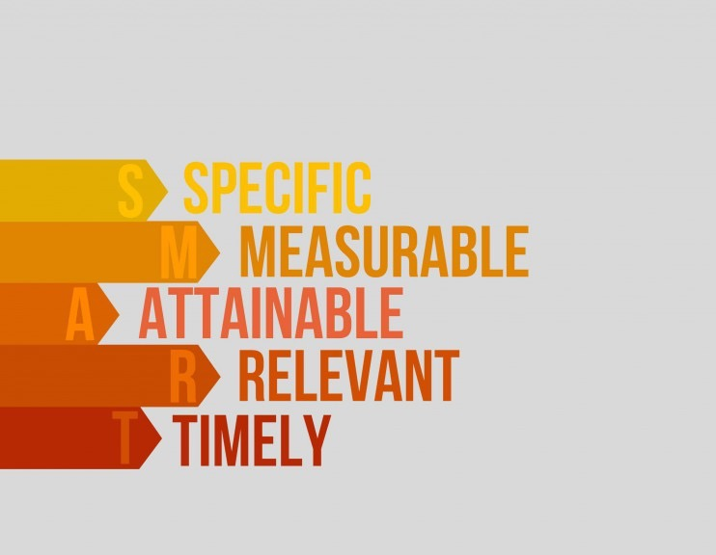
KPIs make your goals SMART
Notes:
Ambiguous KPIs allow everyone to interpret them differently
Some KPIs are more measurable than others, but try
Often a mix of easy to achieve and stretch targets

Slide 8
KPIs are the few metrics that matter most
Shoot for 5-10
top-level KPIs
for your org
KPIs
As summaries
As indicators
Other important metrics
Notes:
Not everything you measure
Too many: Everyone will cherrypick which ones matter to them, no shared prioritization
Too few: Won’t cover the full range of your operation and impact; unintended consequences (glass factory)
Can apply this to your entire org or to a dept or project (fewer KPIs recommended)
KPIs as summaries of deeper metrics
KPIs as indicators of what’s happening deeper, signals for when to examine specific metrics

Slide 9
NPR goals and associated KPIs and metrics
NPR Strategic Plan & Board
Organizational
Divisional
Individual
Notes:
Alignment of different levels
Each division also has its own pyramid with levels: Marketing > Team > Individual

Slide 10
Look at all parts of your organization
Financial
Operational
HR
Marketing
Programming
Editorial
Digital
Audience
Technical
Not one KPI per group, but rather the shared goals that all groups have an impact on
Notes:
All areas of your org so everyone feels that their work connects to overall success
Doesn’t mean a KPI per group – explore high-level goals/metrics that all groups feed into, impact they have
Grow audience: many teams contribute

Slide 11
How do we establish KPIs
for our station
or group
or project?

Slide 12
Resist temptation
Don’t merely document current habits – step back and revisit which metrics matter
Don’t simply use someone else’s KPIs without examining them against your own goals
Don’t start with listing metrics
Notes:
It’s tempting to just stick with the things you already measure instead of look at what metrics might be better

Slide 13
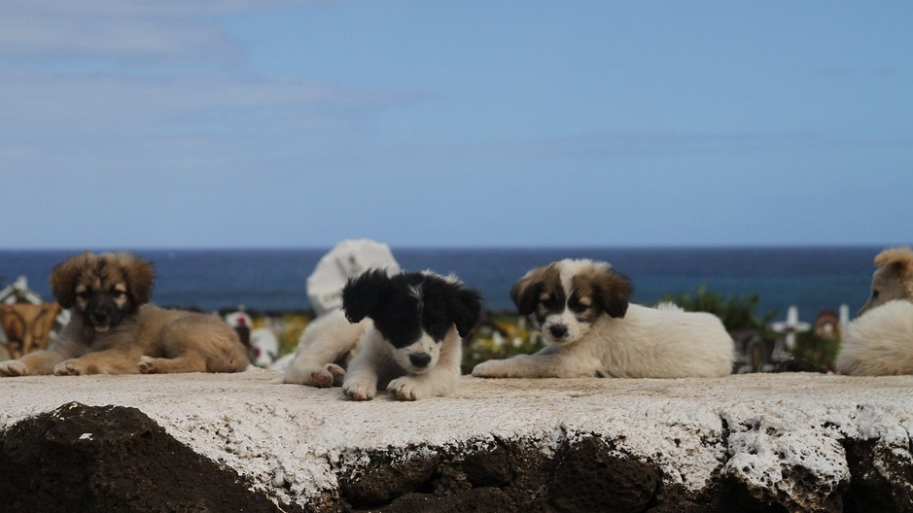
Assemble your team
1
Travel Aficionado, Flickr
Notes:
Puppies as shameless pandering for your attention and approval
https://www.flickr.com/photos/travel_aficionado/6599138729

Slide 14
Relationships, relationships, relationships
…and politics
Find allies
People who value a focus on goals and measurement
Influencers who are well connected
Cover key areas of your station
Leaving out one core group can backfire
But smaller, nimble teams can move faster
Seek out an executive sponsor
KPIs can drive an organization and you want their buy-in
Others will take your work seriously if it’s blessed
Notes:
So much of this is about knowing your culture

Slide 15
NPR KPIs team
President, Operations
Senior Director, Audience Insights
Managing Editor, Digital News
Senior Director, Programming
VP Product, Digital Media
VP Business Development
Senior Director, Finance
Senior Director, HR
Senior Project Manager, Executive Group
Notes:
Exec sponsor
Range of divisions
Leaders and influencers

Slide 16
Texas journalism hub:
metrics team
VP for Radio, KERA
Senior Director, Audience Insights, NPR
Exec Director of Operations, Houston Public Media
Associate General Manager, Development and Marketing, KUT
News Director, Texas Public Radio
Statewide Coordinating Editor for the Texas Station Collaborative
Texas Hub Project Manager, KERA
Notes:
Even though it’s a journalism hub, the team isn’t just newsroom folks
Broad collaboration and impacts

Slide 17
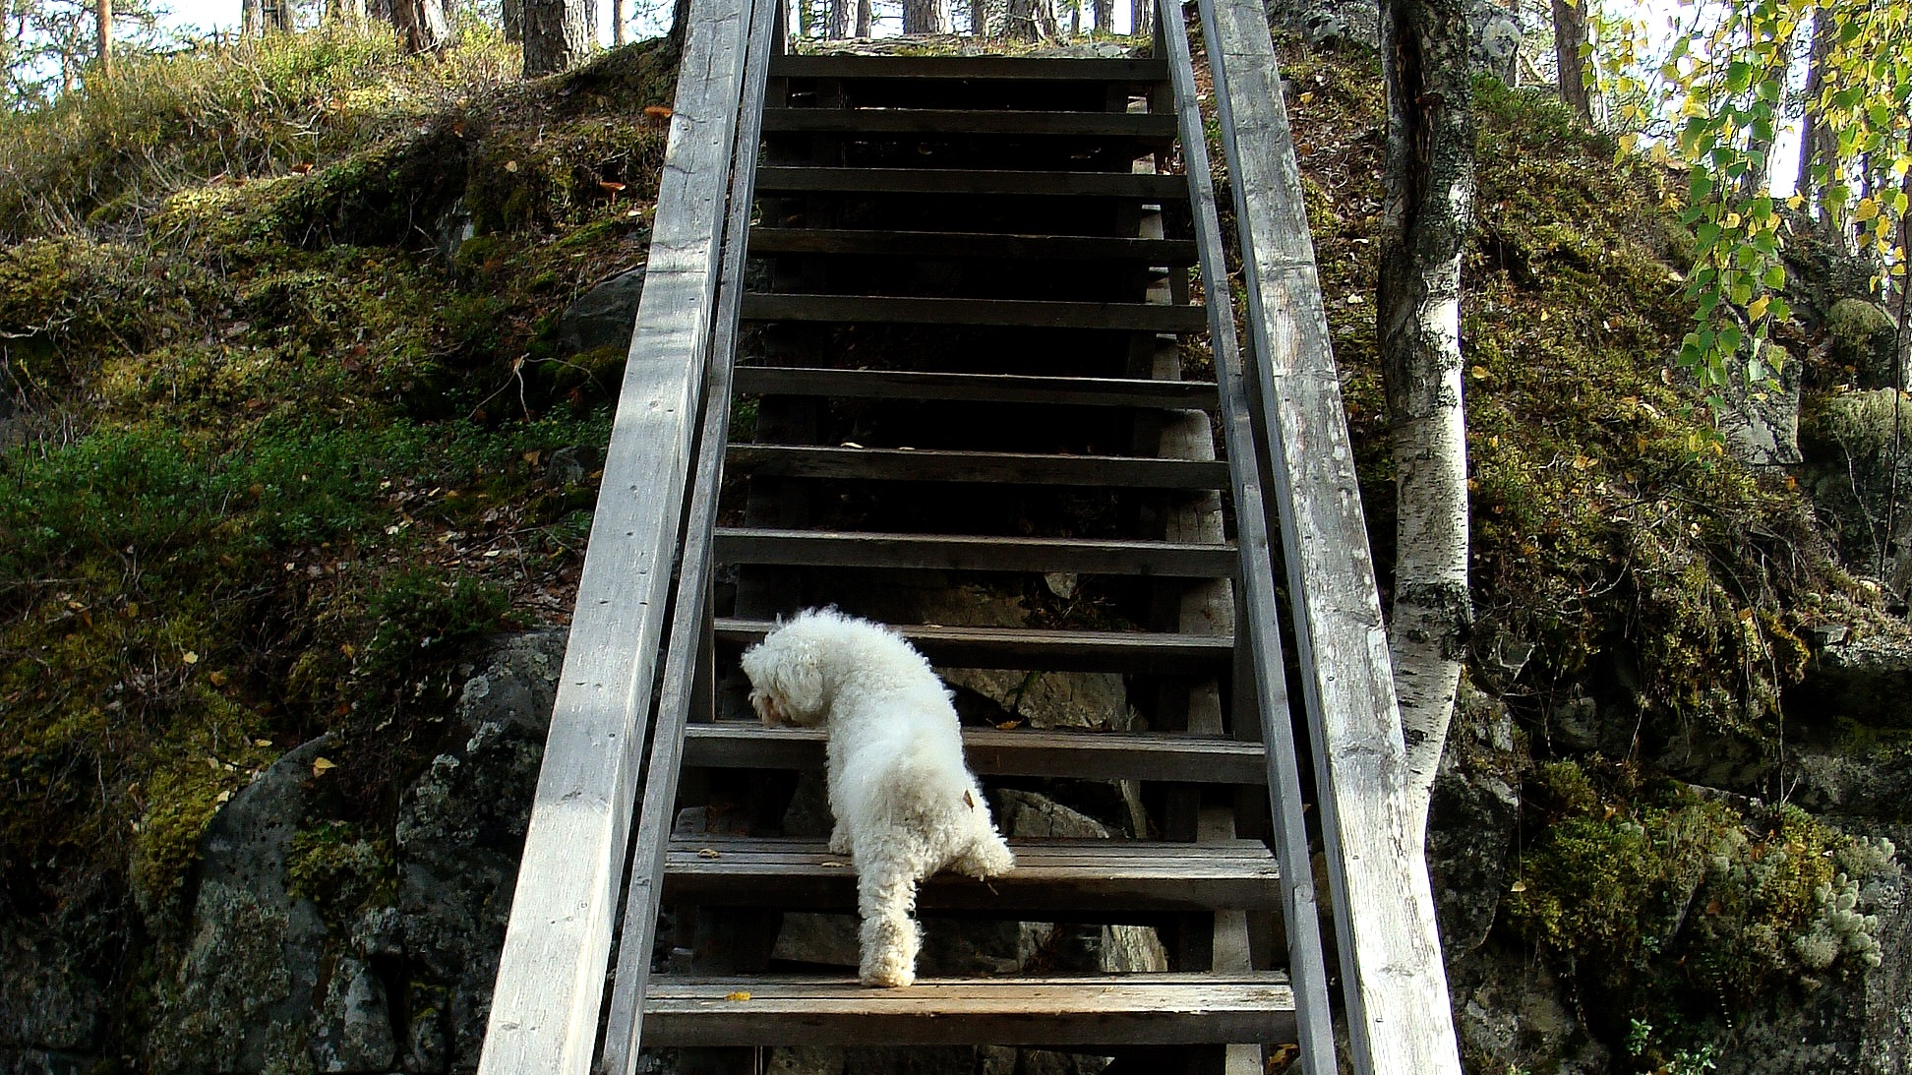
Confirm core goals
2
itsjustminna, Flickr
Notes:
https://www.flickr.com/photos/31793919@N03/4061435651

Slide 18

Goals are the center of gravity
If there aren’t agreed-upon goals to connect the KPIs to, just stop

Slide 19

KPIs without goals are like…
flowers without stems
Philippa Willitts, Flickr
Notes:
No longer rooted to anything
If disconnected from a goal, will die, feel arbitrary and ignored
https://www.flickr.com/photos/hippie/1341204435

Slide 20
NPR Strategic Plan goals
REACH
Expand the number of people who engage with NPR to ensure we are building the next core audience even as we deepen the affinity of our current audience.
REWARD
Grow revenues, resources, and reserves by optimizing existing revenue streams, growing our endowment, seizing new business opportunities, reducing dependence on station fees.
RELATIONSHIPS
Deepen the connections that audiences have to each other and NPR by creating distinctive, meaningful content and experiences, build a true collaborative network between Member stations and NPR that strengthens public radio’s journalism, audience service, and sustainability, and ensure
a respectful and effective culture within NPR.

Slide 21
Texas journalism hub:
example goals
Provide better service – locally, regionally, nationally – by connecting, planning, and coordinating news coverage together. Be better stewards of resources, reduce redundancies, and free up resources for better, more strategic news coverage.
Serve news deserts by sharing resources to tell stories of places we don’t hear from, and help stations in those communities serve the places where they live with better news coverage.
Create news and editorial content that is mission-driven, audience-centered, and data-informed to help ensure we are providing a service that is important and relevant.
Acquire new and sustaining revenue by serving news deserts, adding statewide newscasts, and strengthening reporting on important coverage areas (education, health, legislative, environment, etc.).
Notes:
Write down the goals, get buy-in, don’t assume everyone already has the same goals in mind
Prioritize goals if necessary
Remember, KPIs should be driven by top-down goals, not bottom-up work already underway. Don’t set KPIs to merely conform to existing work.

Slide 22
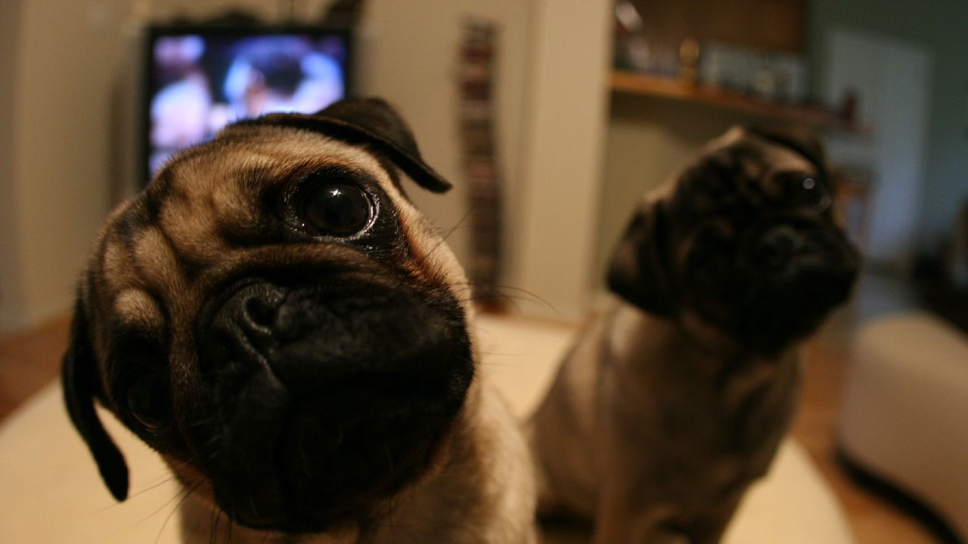
Explore questions people ask
3
T. Bitties, Flickr
Notes:
https://www.flickr.com/photos/21206761@N00/469110140

Slide 23
Questions can flesh out goals
For each goal:
  What are the different facets that people talk about?
  What are the questions teams will or should ask themselves regularly as they work toward this goal?
Questions can flesh out what the goals really mean and suggest metrics that align
goal
possible KPIs
questions
Notes:
Optional step, useful if the goals are really broad or vague, need to clarify what they mean
Another way of honing in on what your KPIs need to align to
Research interviews can help
Could be helpful to list by role

Slide 24
Texas journalism hub:
example questions
Goal: Provide better service....Be better stewards of resources, reduce redundancies, and free up resources for better, more strategic news coverage.
Does our collaborative work save each station time and resources?
Do we use resources more effectively and reduce duplication of efforts?
How much more can we cover thanks to freed-up resources?
Does our collaboration help us better reflect all of America in our stories?
How does this collaboration expand the skills of newsrooms?
Does our collaborative work grow on-air and digital audience?
Does our collaborative work reach more diverse or underserved audiences (ethnicity, age, locations)?

Slide 25
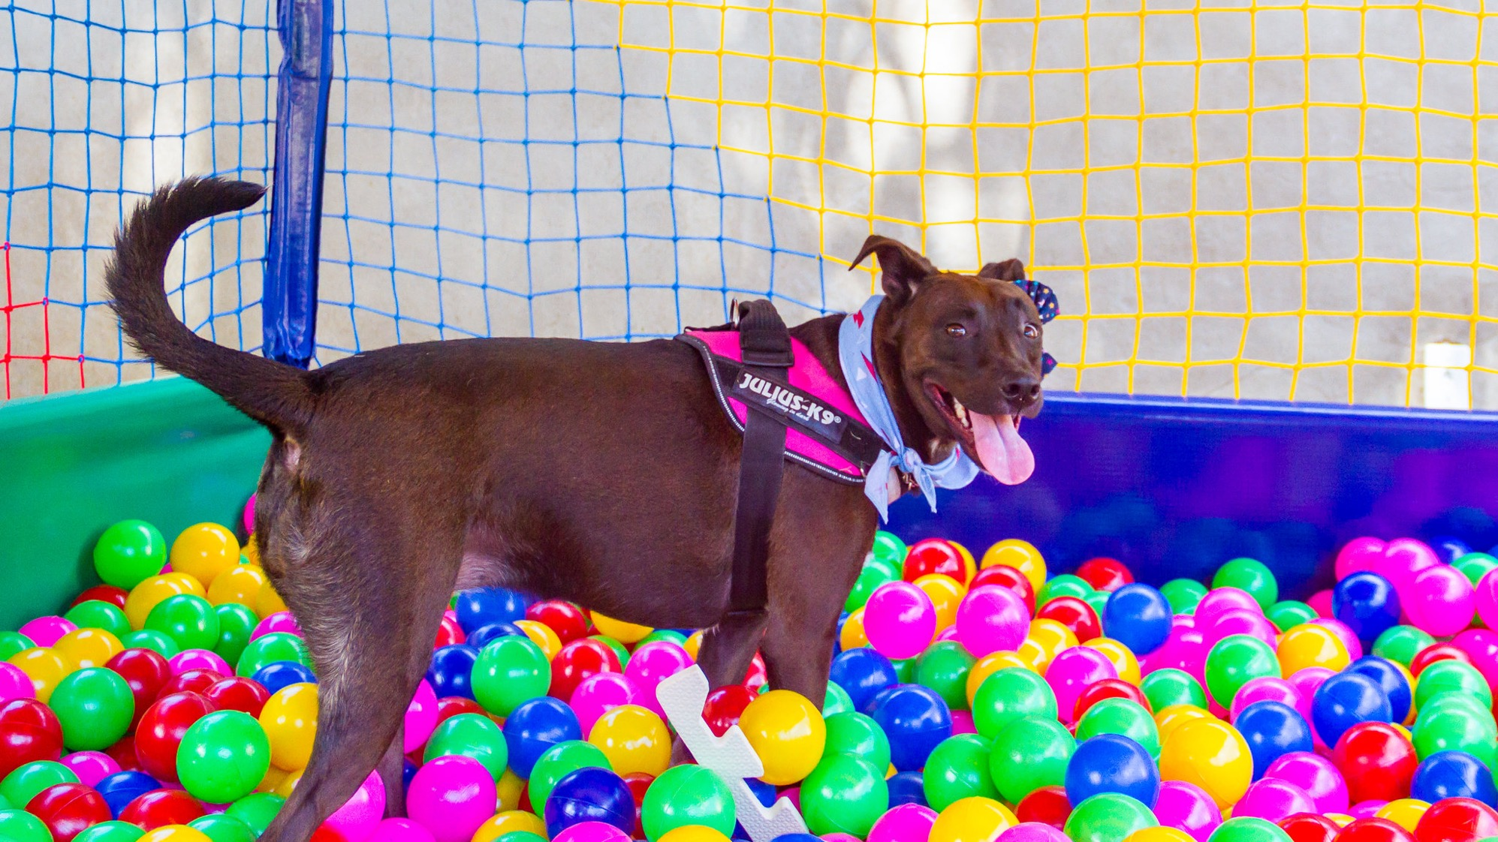
Identify potential metrics
4
Lua Bittencourt, Flickr
Notes:
https://www.flickr.com/photos/147625560@N07/30929844417

Slide 26
Start with quantity not quality
Brainstorming KPI candidates:
  Down from each goal
  Up from each question
All the possible ways of measuring that could signal progress on each goal, directly or indirectly
  Start with what you already measure, then expand the list
  Include things that might be hard to measure
Quantitative data
  Raw numbers: financials, audience metrics, listener emails, story counts, awards, etc.
  Ratios: % site visitors, % staff turnover, etc.
Qualitative measures
  Perceptions and attitudes: staff polls, success stories, anecdotes

Slide 27
Public media KPIs: Brainstorming on audience engagement
Platform | Metric | Question we're trying to answer
Website | Time per user | How much time is the average person spending with our content each week or month, signaling loyalty and potential support?
Website | Pages per user | How many total pages is the average person viewing across all sessions in a given week or month?
Website | Sessions per user | How many times is the average person visiting us each week or month?
Website | Pages per session | How many pages does the average person view in one visit?
Website | Time per session | How much time does the average person spend in one visit?
Website | Bounce rate | How many sessions consist of only one pageview?
Website | Audio plays | How many times did our streams or other audio get played each week or month?
Website | Audio plays per user | How many times did the average person play a stream or other audio across all sessions in a given week or month?
Website | Time listening per user | How much time is the average person spending listening to our streams or other audio each week or month, signalling loyalty and potential support?
Website | Custom calculated metric | How engaged is the average person as shown in a combination of metrics?
App | Time per user
App | Screens per user
App | Sessions per user
App | Screens per session
App | Time per session
App | Audio plays
App | Audio plays per user
App | Time listening per user
App | Custom calculated metric
Live streams | Time per user
Live streams | Sessions per user
Live streams | Time per session (ATSL)
Podcasts/segments | Time per user
Podcasts/segments | Downloads per user
NPR One | Time per user
NPR One | Sessions per user
NPR One | Story completion rate
NPR One | Story love rate (interesting + shares)
Video | Time per user
Video | Plays per user
Facebook | Click-through rate (clicks/impressions)
Facebook | Clicks per user reached
Facebook | Clicks per engaged user
Facebook | Engagement rate
Facebook | Total clicks
Facebook | Total shares
Email | Open rate
Email | Click-through rate (clicks/opens)

Slide 28
Texas journalism hub: Framework for brainstorming
Metric | Question we're trying to answer
HOW WE WORK
Resources or time dedicated to a specific story | Does our collaborative work save each station time and resources?
Total number of reporters covering certain events | Do we use resources more effectively and reduce duplication of efforts?
Additional stories covered due to new resource efficiencies | How much more can we cover thanks to freed-up resources? How are you leveraging added resources?
New revenue related to collaborative hubs | What new revenue is directly attributable to our collaboration?
Cost savings related to collaborative hubs | What cost savings are directly attributable to our collaboration?
Training, developing new skills | How does this collaboration expand the skills of our newsrooms?
Our perceptions of collaboration effectiveness | What do all the participants think of the collaboration?
WHAT WE CREATE
Fewer unintended duplicated stories | Does our collaborative work save each station time and resources?
Larger total pool of unique stories (net gain) | How much more can we cover thanks to freed-up resources?
# by type: statewide newscasts, investigative stories, in-depth features, cut-and-copies, cut-downs (1-min versions), digital stories | How much more can we cover thanks to freed-up resources?
# of stories that include tape from other stations | How much more can we cover thanks to freed-up resources?
Diversity of voices | Does our collaboration help us better reflect all of America in our stories?
# local stories per hour of drive time
# of times hub stories used (broadcast & digital) on station platforms | Is our collaborative work getting enough exposure?
# of times hub stories used (broadcast & digital) on NPR platforms | Is our collaborative work getting enough exposure?
# of times hub stories used/promoted (broadcast & digital) on social media | Is our collaborative work getting enough exposure?
% of on-air programming coming from hub | Is our collaborative work getting enough exposure?
Our perceptions of hub content as timely, relevant, matching high standards | What do all the participants think of the content produced?
WHO WE SERVE
Broadcast cume | Does our collaborative work grow on-air audience for participating stations?
Broadcast AQH | Does our collaborative work grow on-air listening for participating stations?
Broadcast audience demographics | Does our collaborative work reach more diverse or underserved audiences (ethnicity, age, locations)?
Total exposures to hub stories | How many times is our collaborative work being heard and/or read across platforms?
Total website users | Does our collaborative work grow website audience for participating stations?
Total app users | Does our collaborative work grow app audience for participating stations?
New website users who begin on hub stories | Does our collaborative audience bring in first-time site visitors?
Digital pageviews and plays per hub story | How many views and plays do hub stories receive compared to other stories?
NPR One average completion rate and love rate | Are collaborative stories at least as engaging as other stories on NPR One?
Facebook reach and engagements per hub story | Do collaborative stories drive audience engagement on Facebook?
Audience satisfaction with content | What does our audience think of us and does that change over time?
Media mentions of hub stories | Do collaborative stories get more media coverage/citations than the average?
Media mentions about the hub itself | Does the hub itself generate coverage?
Policy/legislation impacts of our stories | Does our collaborative coverage lead to policy change?
Awards | Do collaborative stories result in new awards?
Notes:
Framework can help structure brainstorming, make sure you don’t miss any key area
Make sure your KPIs aren’t all about what you produce – focus on impact too

Slide 29
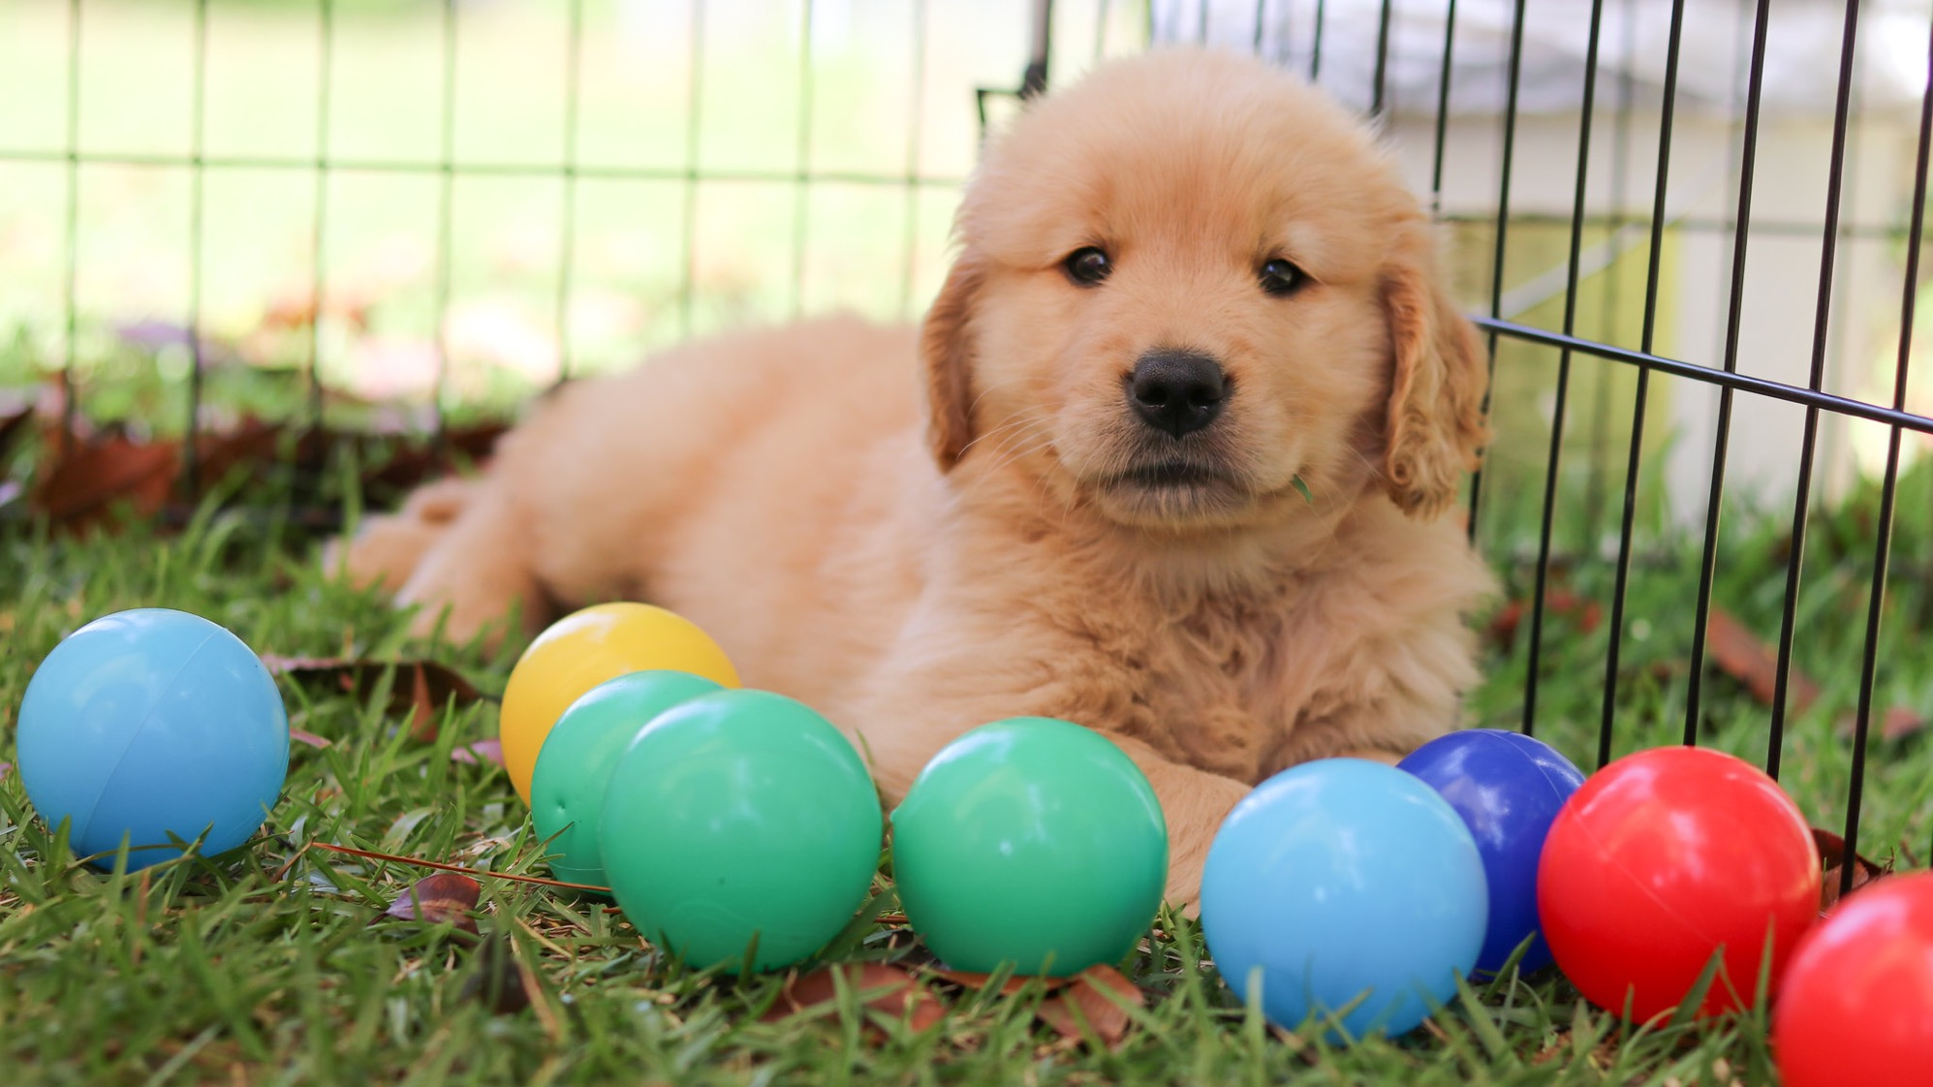
Evaluate
5
the metrics
LNB Photo, Flickr
Notes:
https://www.flickr.com/photos/108284731@N02/26434635487

Slide 30
Time to winnow the list of KPI candidates
Evaluate by:
Alignment to goals
  Familiar/intuitive way of talking about this goal?
  Direct or indirect indicator?
Who will use the data and how
  Is it a vanity metric or will it actually inform decision making and be acted upon?
Pros and cons of this metric vs others
Level of effort to set up and do ongoing reporting
  Requires a rough sense of data source, workflow, frequency
Notes:
Hub newscasts: broadcast indirect, lots of factors; downloads more direct metric

Slide 31
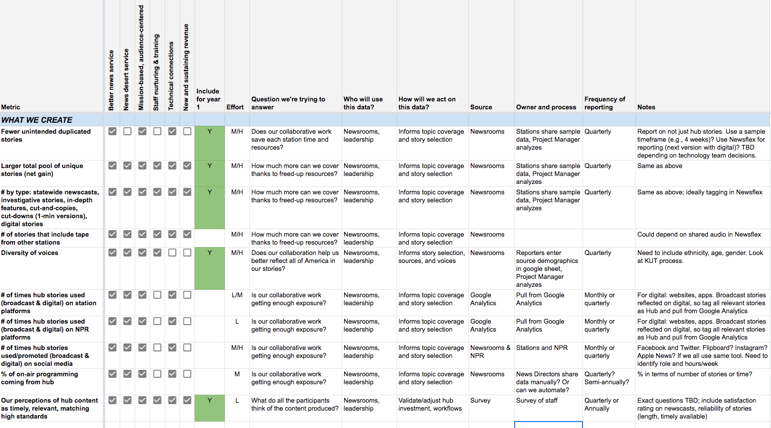
Texas journalism hub: Evaluating the metrics

Slide 32

Prioritize the KPIs
6
Soggydan Benenovitch, Flickr
Notes:
https://www.flickr.com/photos/soggydan/40623832691

Slide 33
Iterate, prioritize, review,
iterate
What are the fewest metrics that can tell the story of the goals? Those are the KPIs.
Sniff tests:
  Do the KPIs cover all goals?
  Will every team see themselves and their work in these KPIs?
  Do they reflect current and future key initiatives? If they don’t, is there a good reason?
Review and iterate with teams
Review and iterate with stakeholders
Notes:
Allow time for iteration
Some people won’t pay enough attention to this work until they see a draft, then they care a lot
When reviewing, explain/propose how KPIs will be used

Slide 34
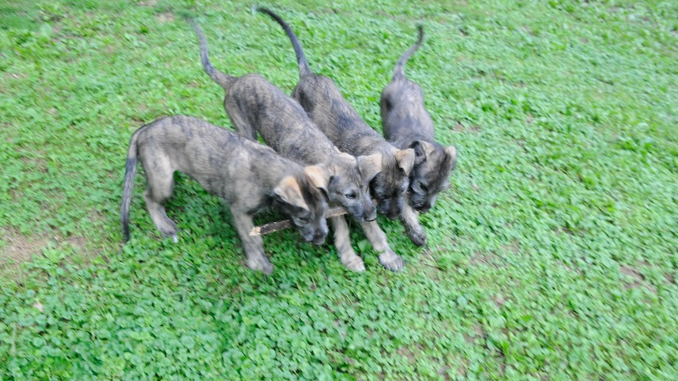
Set owners and methodology
7
Paul Plummer, Flickr
Notes:
https://www.flickr.com/photos/silver_plum_digital/3601869202

Slide 35
Lock down ownership and workflow
Some KPIs will have clear owners, other KPIs will be shared – make that explicit
Bring in experts to finalize the methodology and frequency for each KPI
  What new work is required to make it possible?
  What ongoing work is needed?
  How exactly will the numbers be calculated?
  How often will they be shared and where will they live?
KPI | Methodology
Voice assistant weekly total listening hours | Newscasts, podcasts, and streams. Splunk & Triton, weekly average over entire fiscal year.

Slide 36
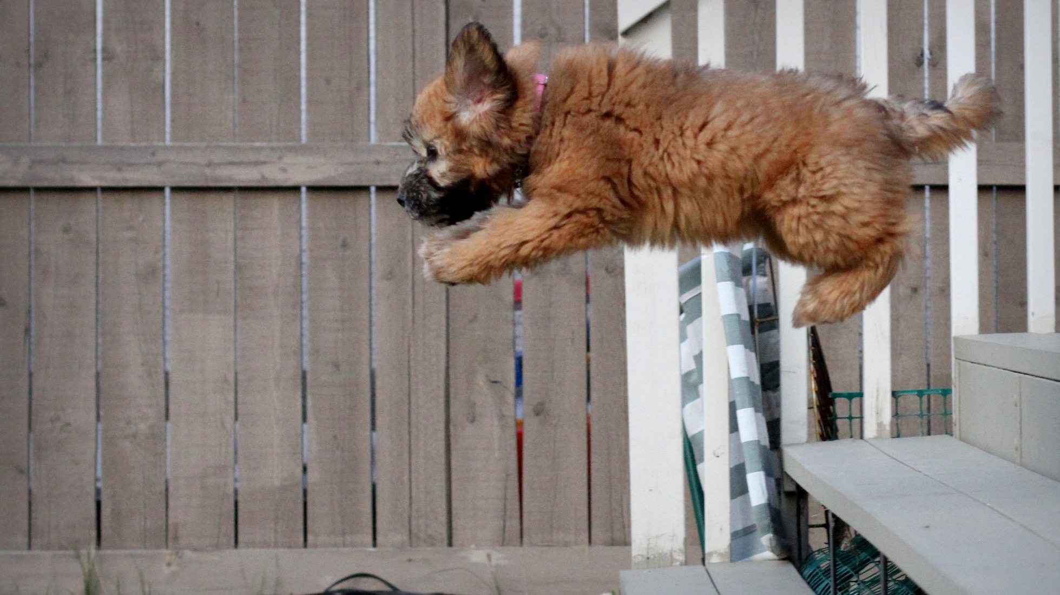
Establish targets
8
Sangudo, Flickr
Notes:
https://www.flickr.com/photos/sangudo/7246007370

Slide 37
Use targets to motivate and reward
Specific targets define what success means and motivate people
Include a number and a timeframe
Be intentional about how the targets you set communicate priorities:
  Stretch targets push teams on top priorities
  Conservative targets reflect organic growth
Treat targets as achievable ambitions, not legally binding contracts or career-ending threats

Slide 38
How do we use the KPIs?

Slide 39
Share broadly
Goals and KPIs bring focus only if everyone knows about them
Repetition is your friend – making them part of your shared vocabulary and culture takes time
Notes:
Public media metrics: Current article, posters sent to stations, conference presentations
NPR: Loren weekly email, all staff meeting, one-sheeter

Slide 40
Embed in regular processes
Report on the KPIs at least quarterly
  Be transparent – the good and the bad
Create expectations that the KPIs will be part of:
  Regular team meetings
  Regular executive status meetings
  Goal setting for teams and individuals
  Strategic planning and roadmap processes
  Annual reviews

Slide 41

If you want KPIs to bring focus and energy…
keep them alive
Michael Frank Franz, Flickr
Notes:
KPIs as nice to have vs the way we do our work
https://www.flickr.com/photos/nwater/14449268334

Slide 42
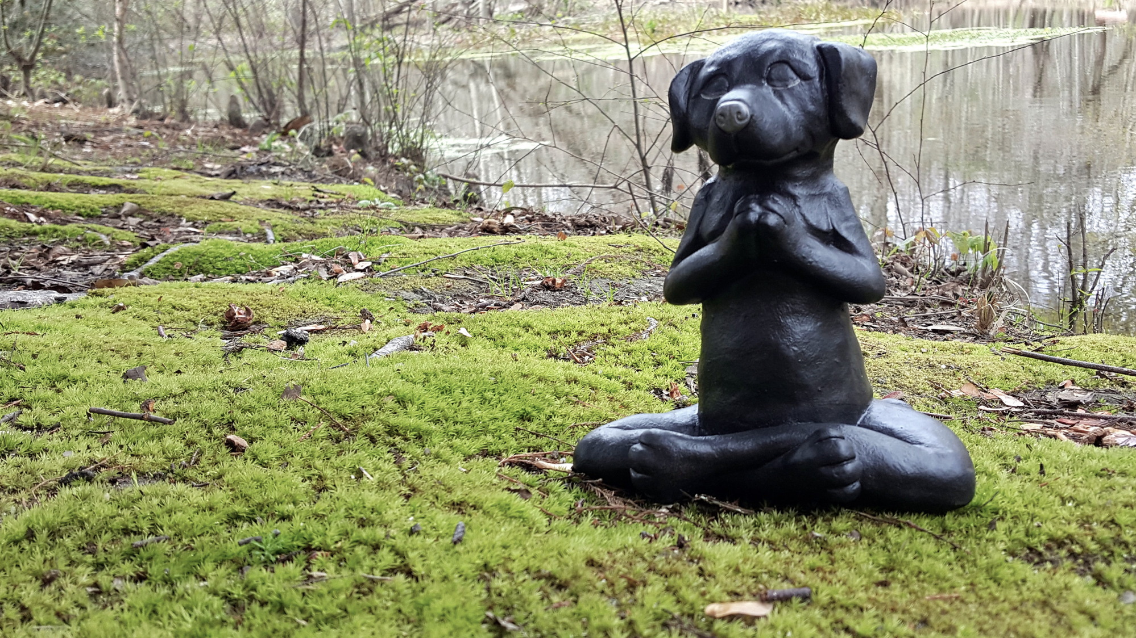
Thank you
smulder@npr.org
Public media digital KPIs:
tinyurl.com/pubmediakpis

